Slide 1
Binary Operations
Presented By:
Elizer Ponio Jr.
Department of Computer Science

Slide 2
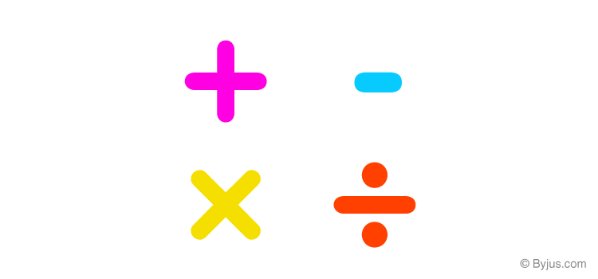
Binary Operations
You can add, subtract, multiply, and divide binary numbers using various methods.
These operations are much easier than decimal number arithmetic operations because the binary system has only two digits: 0 and 1.

Slide 3
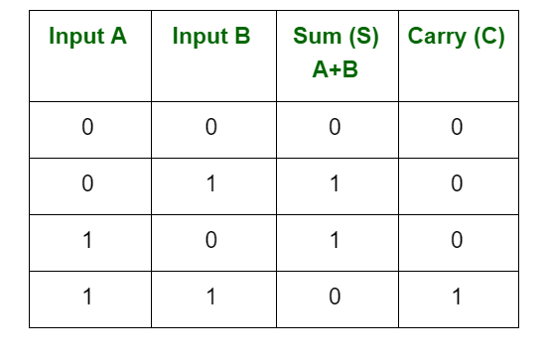
Binary Addition

Slide 4
Binary Addition
Carry 1
1 0 1
(+) 1 0 1
-----------
Step 1: First consider the one’s place, and add the one’s place which will give the result 0 carry 1
Step 2: Now add ten’s place.
Step 3: Now add the hundred’s place. Leave the value 0 in the hundred’s place and the carry 1 to the thousand’s place.
1
0
1
0

Slide 5
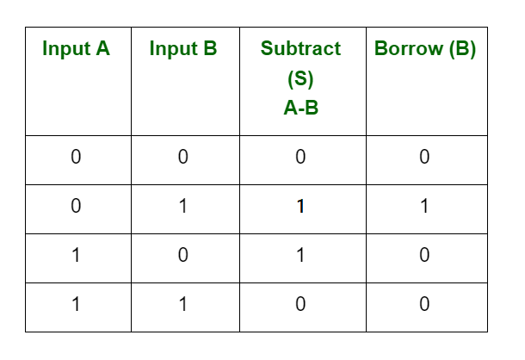
Binary Subtraction

Slide 6
Binary Subtraction
Borrow 1
Borrow 1
0
1
1
              0 0
              (-) 1 0 1
-----------
0
Step 1: First consider the one’s column, and subtract the one’s column,( 0 – 1 ) and it gives the result 1 as per the condition of binary subtraction with a borrow of 1 from the 10’s place.
Step 2: After borrowing 1 from the ten’s column, the value 1 in the 10’s column is changed into the value 0
Step 3: So, subtract the value in the ten’s place, ( 0 – 0 ) = 0.
0
1
0
1
Step 4: Now subtract the values in 100’s place. Borrow 1 from the 1000’s place ( 0 – 1 )

Slide 7
More on Borrowing

Slide 8
Borrowing
1
0
              0 0
              (-) 1 1 0
-----------

Slide 9
Borrowing
1
0
              0 0
              (-) 1 1 0
-----------
We start with the one’s place
0

Slide 10
Borrowing
1
0
              0 0
              (-) 1 1 0
-----------
And then we shift to the ten’s place
0

Slide 11
Borrowing
1
0
              0 0
              (-) 1 1 0
-----------
Because we subtract 0 and 1 in the ten’s place, we need to borrow 1 from the hundred’s place
0

Slide 12
Borrowing
1
0
              0 0
              (-) 1 1 0
-----------
But we can see that we cannot borrow zero from the hundred’s place because it is a zero.
0

Slide 13

Borrowing
1
0
              0 0
              (-) 1 1 0
-----------
But we can see that we cannot borrow zero from the hundred’s place because it is a zero.
What we need to do is to borrow the one from the thousand’s place.
0

Slide 14

Borrowing
1
0
              0 0
              (-) 1 1 0
-----------
When we borrow, we are effectively giving two 1’s on the hundred’s place.
0

Slide 15
Borrowing
1
0
              0 0
              (-) 1 1 0
-----------
When we borrow, we are effectively giving two 1’s on the hundred’s place.
And because we need the one from the tens place, we need to get the one from the thousands place and move it to the ten’s place
0

Slide 16
Borrowing
1
0
              0 0
              (-) 1 1 0
-----------
When we borrow, we are effectively giving two 1’s on the hundred’s place.
And because we need the one from the tens place, we need to get the one from the thousands place and move it to the ten’s place
Giving the ten’s place two ones.
0

Slide 17
Borrowing
1
0
              0 0
              (-) 1 1 0
-----------
Now we perform subtraction…
0

Slide 18
Borrowing
1
0
              0 0
              (-) 1 1 0
-----------
Going back to the ten’s place, we subtract with the borrowed ones
1 – 1 – 0 – 1 = 1
1
0

Slide 19
Borrowing
1
0
              0 0
              (-) 1 1 0
-----------
And then we go to the hundred’s place, we subtract with the borrowed one
1 – 0 – 1 = 0
0
1
0

Slide 20
Borrowing
1
0
              0 0
              (-) 1 1 0
-----------
And then we go to the thousand’s place, here we just bring down 0
0
0
1
0

Slide 21
Borrowing
1
0
              0 0
              (-) 1 1 0
-----------
We get 0010
0
0
1
0

Slide 22
Borrowing
1
0
              0 0
              (-) 1 1 0
-----------
To verify this, we can convert this to decimal
0
0
1
0

Slide 23
Borrowing
1
0
              0 0
              (-) 1 1 0
-----------
              8
              (-) 6
-----------
0
0
1
0
2

Slide 24
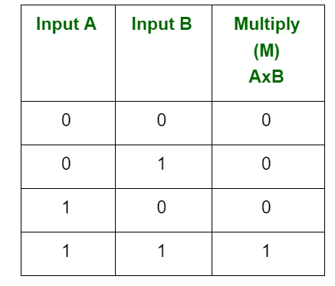
Binary Multiplication

Slide 25
Binary Multiplication
1 0 1 0
x 0 1 1 0
-----------
0 0 0 0
1 0 1 0
1 0 1 0
(+)
0 0 0 0
----------------
0 1 1 1 1 0 0

Slide 26
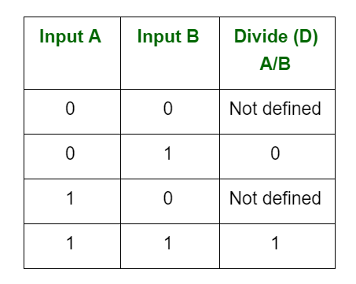
Binary Division

Slide 27

Binary Division
1
0
0
1
Step 1: Count the number of bits of the divisor. 101 has 3 bits.
1 0 1
1 0 1 1 0 1
-
1 0 1
---------------
Step 2: Get the last three bits of the dividend starting from the left.
0
1
0
1
-
1 0 1
Step 3: Perform division. 101 / 101 is 1.
---------------
Step 4: Multiply the quotient and the divisor. 101 x 1 is equal to 101
0
Step 5: Perform subtraction
Step 6: Each time we bring down a number, add a zero to the quotient.
Step 6: Repeat step 3, 4 and 5

Slide 28
Binary Division
1 1 0
1 0 1 1 0 0 1

Slide 29
Binary Division
0 0 0
1 1 0
1 0 1 1 0 0 1
We start by counting the number of bits of the divisor

Slide 30
Binary Division
0 0 0
1
1 1 0
1 0 1 1 0 0 1
Because 110 is larger than 101, we need to shift one bit to the right to divide 110 with a larger number.
By doing this, we will now divide 1011 with 110

Slide 31
Binary Division
0 0 0
1
1 1 0
1 0 1 1 0 0 1
-
1 1 0
---------------

Slide 32
Binary Division
0 0 0
1
1 1 0
1 0 1 1 0 0 1
-
1 1 0
---------------
1 0 1

Slide 33
Binary Division
0 0 0
1
1 1 0
1 0 1 1 0 0 1
-
1 1 0
---------------
1 0 1 0

Slide 34
Binary Division
0 0 0
1
1
1 1 0
1 0 1 1 0 0 1
-
1 1 0
---------------
1 0 1 0

Slide 35
Binary Division
0 0 0
1
1
1 1 0
1 0 1 1 0 0 1
-
1 1 0
---------------
1 0 1 0
-
1 1 0
---------------

Slide 36
Binary Division
0 0 0
1
1
1 1 0
1 0 1 1 0 0 1
-
1 1 0
---------------
1 0 1 0
-
1 1 0
---------------
1 0 0

Slide 37
Binary Division
0 0 0
1
1
1 1 0
1 0 1 1 0 0 1
-
1 1 0
---------------
1 0 1 0
-
1 1 0
---------------
1 0 0 0

Slide 38
Binary Division
0 0 0
1
1
1
1 1 0
1 0 1 1 0 0 1
-
1 1 0
---------------
1 0 1 0
-
1 1 0
---------------
1 0 0 0

Slide 39
Binary Division
0 0 0
1
1
1
1 1 0
1 0 1 1 0 0 1
-
1 1 0
---------------
1 0 1 0
-
1 1 0
---------------
1 0 0 0
-
1 1 0
---------------

Slide 40
Binary Division
0 0 0
1
1
1
1 1 0
1 0 1 1 0 0 1
-
1 1 0
---------------
1 0 1 0
-
1 1 0
---------------
1 0 0 0
-
1 1 0
---------------
0 0 1 0

Slide 41
Binary Division
0 0 0
1
1
1
1 1 0
1 0 1 1 0 0 1
-
1 1 0
---------------
1 0 1 0
-
1 1 0
---------------
1 0 0 0
-
1 1 0
---------------
0 0 1 0

Slide 42
Binary Division
0 0 0
1
1
1
1 1 0
1 0 1 1 0 0 1
-
1 1 0
---------------
1 0 1 0
-
1 1 0
---------------
1 0 0 0
-
1 1 0
---------------
0 0 1 0 1

Slide 43
Binary Division
0 0 0
1
1
1
0
1 1 0
1 0 1 1 0 0 1
-
1 1 0
---------------
1 0 1 0
-
1 1 0
---------------
1 0 0 0
-
1 1 0
---------------
0 0 1 0 1

Slide 44
Binary Division
0 0 0
1
1
1
0
1 1 0
1 0 1 1 0 0 1
-
1 1 0
---------------
1 0 1 0
-
1 1 0
---------------
1 0 0 0
-
1 1 0
---------------
0 0 1 0 1
-
0
---------------

Slide 45
Binary Division
0 0 0
1
1
1
0
1 1 0
1 0 1 1 0 0 1
-
1 1 0
---------------
1 0 1 0
-
1 1 0
---------------
1 0 0 0
-
1 1 0
---------------
0 0 1 0 1
-
0
---------------
0 0 1 0 1

Slide 46
Binary Division
0 0 0
1
1
1
0
1 1 0
1 0 1 1 0 0 1
-
1 1 0
---------------
1 0 1 0
-
1 1 0
---------------
Answer
0001110.101
1 0 0 0
-
1 1 0
---------------
0 0 1 0 1
-
0
---------------
0 0 1 0 1

